Slide 1
Module 3 (Part II)
The xUnit Architecture

Slide 2
xUnit Family Members (Most popular xUnit test frameworks)
Junit (used with Java)
CppUnit (C++)
Nunit (xUnit for .NET)
PyUnit (Python version of xUnit)
Sunit (used with the Smalltalk language)
vbUnit (xUnit for Visual Basic (VB))
utPLSQL (xUnit for Oracle’s PL/SQL language)
MinUnit (used to test C code)

Slide 3
xUnit Extensions
Many add-on tools are available that extend the functionality of existing unit test frameworks into specialized domains
XMLUnit (xUnit extension to support XML testing)
JUnitPerf (JUnit extension)
Cactus (JUnit extension for unit testing server-side code such as servlets, JSPs)
JFCUnit (extension that supports writing GUI tests)
NUnitForms (extension that supports GUI tests of Windows Forms applications)
HTMLUnit (extension to JUnit that tests web-based applications)
HTTPUnit (Another JUnit extension that tests web-based applications)
Jester (A helpful extension to JUnit that automatically finds and reports code that is not covered by unit tests)

Slide 4
The xUnit Architecture
The xUnits all have the same basic architecture
The other xUnits vary in their implementation details, but follow the same pattern and generally contain the same key classes and concepts
The key classes are
TestCase
TestRunner
TestFixture
TestSuite
TestResult

Slide 5
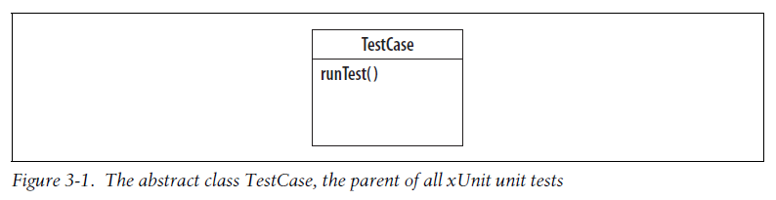
TestCase
xUnit’s most elemental class is TestCase, the base class for a unit test
It is shown in Figure 3-1

Slide 6
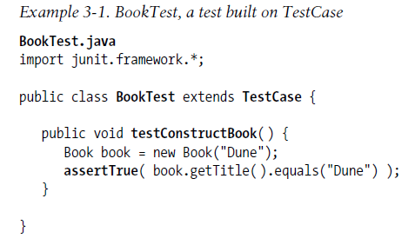
All unit tests are inherited from TestCase
To create a unit test, define a test class that is descended from TestCase and add a test method to it
Example 3-1 shows the unit test BookTest

Slide 7
The test method testConstructBook() uses assertTrue() to check the value of the Book’s title
Test conditions always are evaluated by the framework’s assert methods
If a condition evaluates to TRUE, the framework increments the successful test counter
If it is FALSE, a test failure has occurred and the framework records the details, including the failure’s location in the code
After a failure, the framework skips the rest of the code in the test method, since the test result is already known
BookTest tests the class Book, shown in Example 3-2

Slide 8
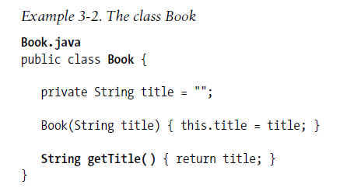

Slide 9
TestRunner
A TestRunner reports details about the test results and simplifies the test
It is a fairly complex object that, in JUnit, comes in three flavors: the AWT TestRunner, the Swing TestRunner, and the textual TestRunner (cleverly named TextTestRunner : Their purpose is to run one or more TestCases and report the results)
Figure 3-2 shows TextTestRunner

Slide 10
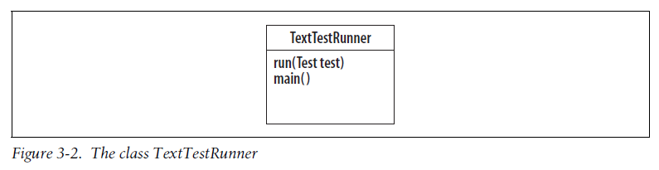
The important methods of TextTestRunner are run(), which gives it a test to run, and main(), which makes TextTestRunner a runnable class
TextTestRunner will be run with the test class BookTest as its argument
It will find the test method testConstructBook and run it.

Slide 11
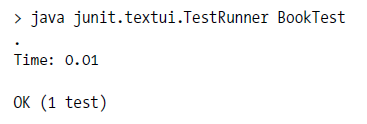
Use TextTestRunner to run BookTest

Slide 12
Using the TestRunner not only takes unnecessary code out of BookTest, but also provides a nice report of how many tests were run and how long they took
Test classes often have multiple test methods
TestRunner will find all of the test methods that have names starting with test and run them
Example 3-5 shows BookTest with a second test method added
The new test validates a Book’s author

Slide 13
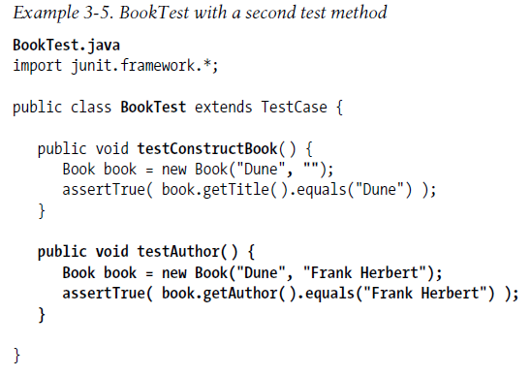

Slide 14
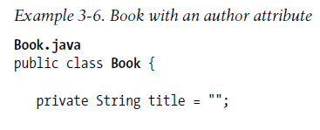
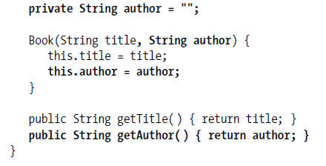
The author attribute and its accessor function getAuthor() are added to Book, as shown in Example 3-6

Slide 15
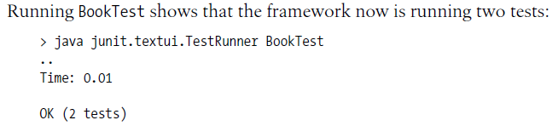

Slide 16
TestFixture
The xUnit architecture helps to ensure test isolation with test fixtures
A test fixture is a test environment used by multiple tests
It is implemented as a TestCase with multiple test methods that share objects
The shared objects represent the common test environment
Figure 3-3 shows the relationship between a TestFixture and a TestCase

Slide 17
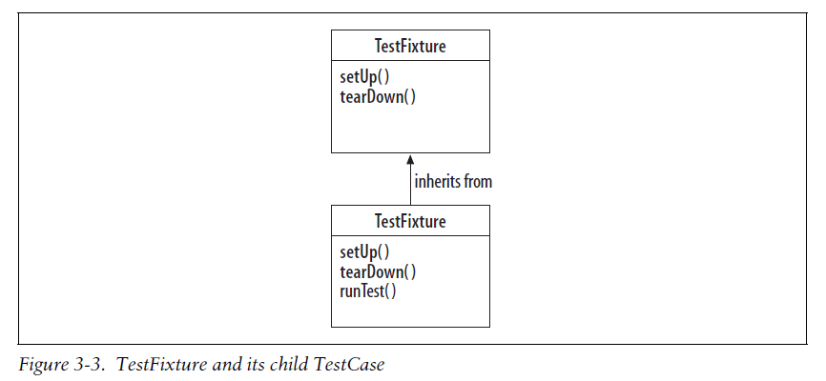
The setUp() method is called prior to each test method, establishing the initial environment for the test
The tearDown() method is always called after each test method to clean up the test environment, even if there is a failure
The TestFixture behavior effectively creates and destroys the test class each time one of its test methods is called

Slide 18
Writing tests as TestFixtures has a number of advantages
Test methods can share objects but still run in isolation
Test coupling is minimized
Test methods that share code can be grouped together in the same TestFixture
Code duplication between tests is reduced
The cleanup code is guaranteed to run whether a test succeeds or fails
Finally, the test methods can be run in any order, since they are isolated
Example 3-9 shows LibraryTest implemented as a TestFixture
In this example, the test fixture’s shared environment contains an instance of Library with two Books

Slide 19
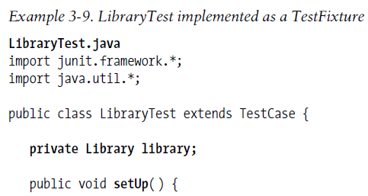
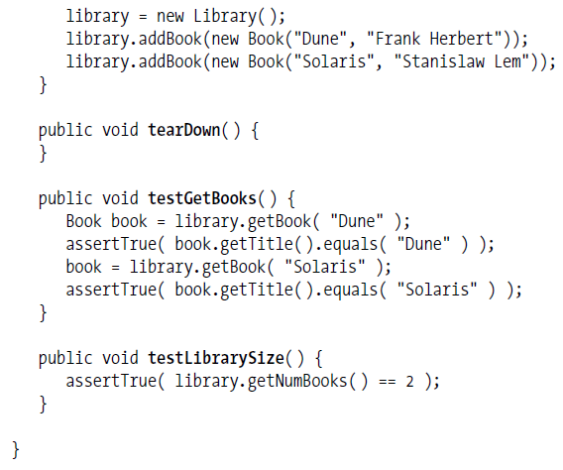

Slide 20
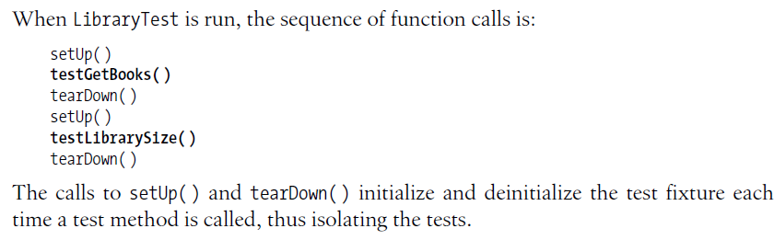

Slide 21
TestSuite
xUnit contains a class for aggregating unit tests called TestSuite
TestSuite is closely related to TestCase, since both are descendants of the same abstract class, Test
Figure 3-4 shows the Test interface and how TestSuite and TestCase implement it

Slide 22
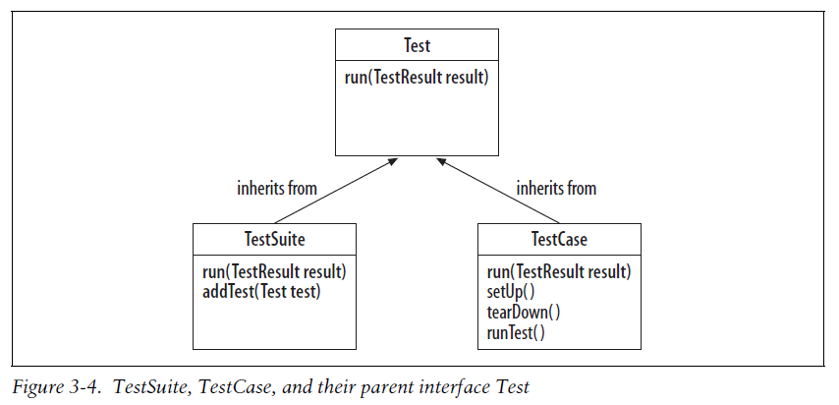

Slide 23
The interface Test contains the run() method that the framework uses to run tests and collect their results
Since TestSuite implements run(), it can be run just like a TestCase
When a TestCase is run, its test methods are run
When a TestSuite is run, its TestCases are run
TestCases are added to a TestSuite using the addTest() method
Since a TestSuite is itself a Test, a TestSuite can contain other TestSuites, allowing the intrepid developer to build hierarchies of TestSuites and TestCases

Slide 24
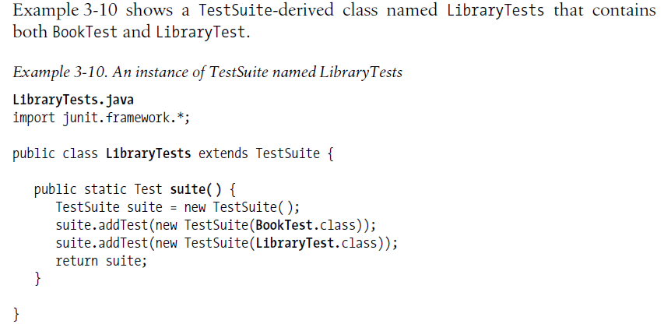

Slide 25
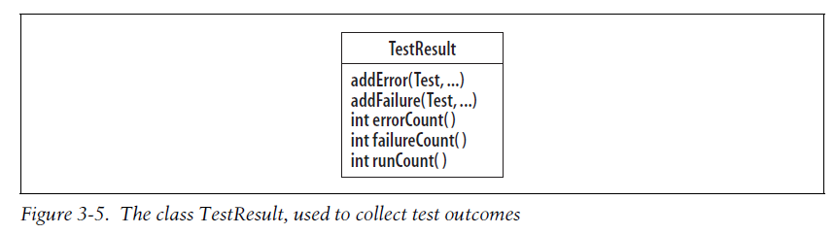
TestResult
Each time a test is run, the TestResult object is passed in to collect the results
Figure 3-5 shows TestResult

Slide 26
TestResult is a simple object
It counts the tests run and collects test failures and errors so the framework can report them
The failures and errors include details about the location in the code where they occurred and any associated test descriptions

Slide 27
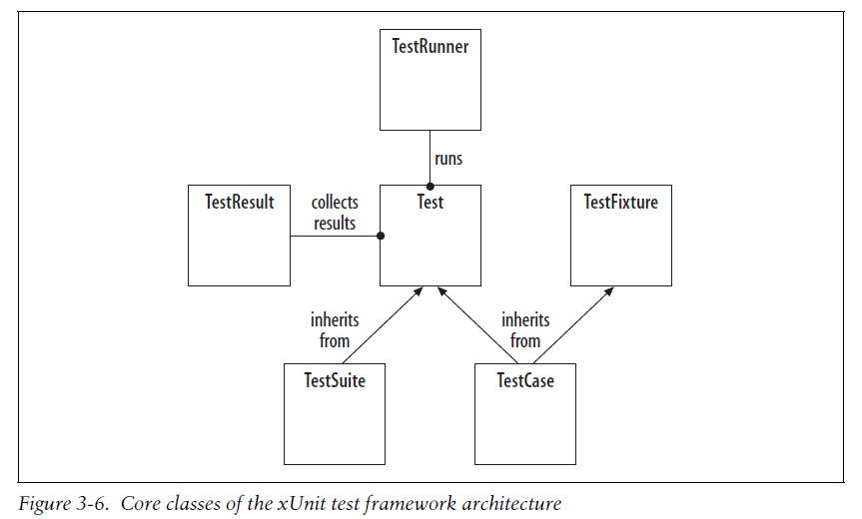
xUnit Architecture Summary

